Slide 1
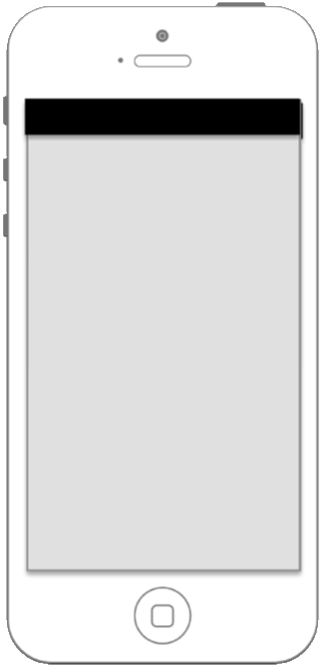


First screen always quiz. To change, go to menu ->
Quiz state
Basic needs
Supporting needs
Surroundings state
Disaster specific information
Extra information

Slide 2
Answer quiz
Quiz state
Map statistics
Basic needs
Disaster Survival tips
Supporting needs
Environrment state
Disaster specific information
Extra information

Slide 3
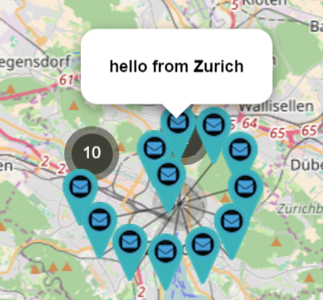





This map shows other people needs:
Water
Swarm Pulse maps ->
Water
Urgent rescue
Water
User selects which type wants to display from a list ->
Food
Medicines

Slide 4




Survival Tips
General preparation for any emergency
Tsunami
Terrorist attack
Tornado
Earthquake

Slide 5
Survive
General preparation for any emergency
Most important documents...
Shows useful information regarding this type of natural disaster ->
Well-stocked go-bag...

Slide 6
Survive
Earthquake
BEFORE…
Shows useful information regarding this type of natural disaster ->
DURING...
AFTER...

Slide 7
Survive
Tsunami
BEFORE…
Shows useful information regarding this type of natural disaster ->
DURING...
AFTER...

Slide 8
Survive
Basic needs
Add question
Add question
Add question
Send

Slide 9
Survive
Supporting needs
Add question
Add question
Add question
Send

Slide 10
Survive
Surroundings state
Add question
Add question
Add question
Send

Slide 11
Survive
Disaster Specific Information
Add question
Add question
Add question
Level of buildings destruction:
Select
I (we) can survive alone for:
Select
Level of water:
Select
Send

Slide 12
Survive
Disaster Specific Information
Someone is injured
Someone is stuck
Someone needs urgent help
Level of buildings destruction:
Select
I (we) can survive alone for:
Select
Level of water:
3-5 meters
None
1-3 meters
3-5 meters
More than 5 meters

